Slide 1
MILAVITSA’S
RETAIL
SALES
VALERYIA LUPANAVA
BI LAB STUDENT
DECEMBER 2, 2017

Slide 2

Business background

Slide 3
International company
Great product variety
MILAVITSA
50 years

Slide 4
BUSINESS PROBLEMS AND NEEDS

Slide 5
absence of historical intelligence
absence of timely access to data
absence of sales and inventory information consolidation
absence of business intelligence from several sources

Slide 6
BENEFITS FROM IMPLEMENTING A DATA WAREHOUSE

Slide 7
#1 better decision-making process
#2 quick and easy access to data
#3 data quality and consistency

Slide 8
DATA DESCRIPTION

Slide 9
The STAR SCHEMA was chosen for business processes description
DIM
#1 simple structure
DIM
DIM
#2 absence of a big amount of tables to join
FACT
#3 widely support by a large amount of business intelligence tools
DIM
DIM

Slide 10
The fact granularity is DAILY SALES AMOUNT per certain CUSTOMER and EMPLOYEE in a specific a STORE

Slide 11
DATA SOURCES
#1 data from the site WWW.MILAVITSA.COM
#1 collections and lines data
#2 sizes data
#2 generated data on the site WWW.MOCKAROO.COM
#1 customers data
#2 employees data
#3 products data
#4 geography data
#3 generated data with SQL
#1 calendar data
#2 sales data

Slide 12
DIMENSIONAL SCHEMA

Slide 13
dim_customers
#1 FOUR SCD2 DIMENSIONS
dim_employees
dim_products
#2 ONE SCD1 DIMENSION
dim_payment_methods
dim_stores
#3 CALENDAR DIMENSION
dim_day_time

Slide 14
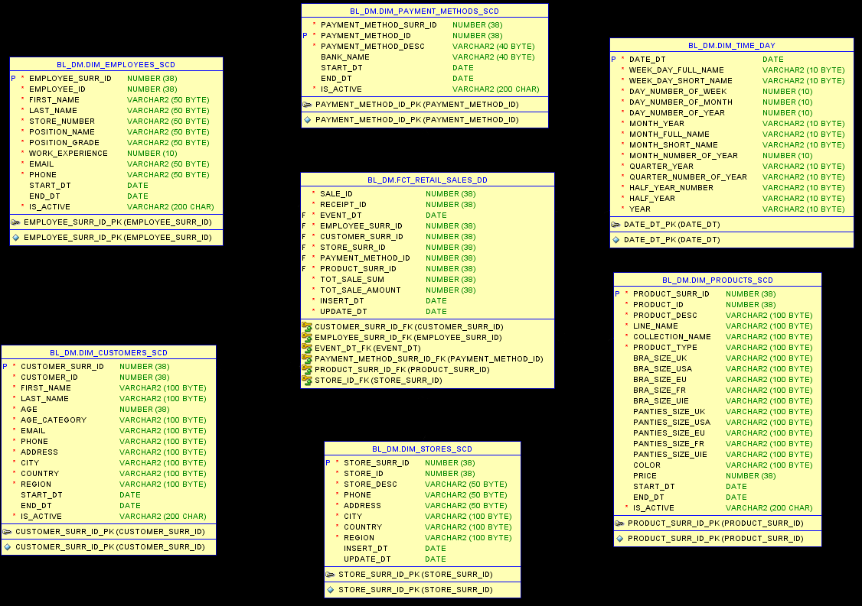

Slide 15
3NF SCHEMA

Slide 16
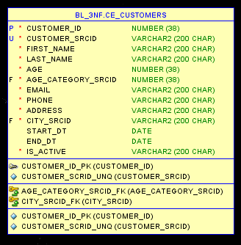
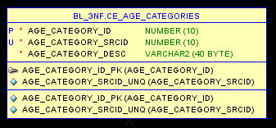

Slide 17
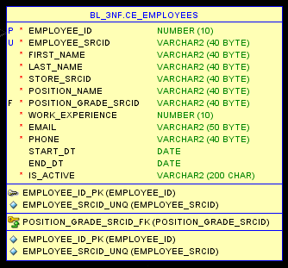
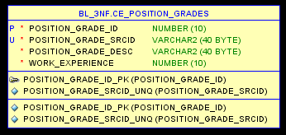

Slide 18
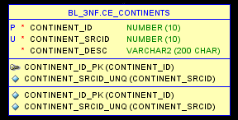
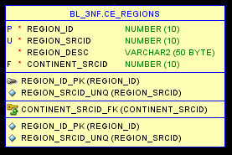
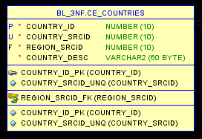
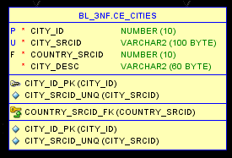

Slide 19
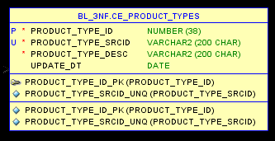
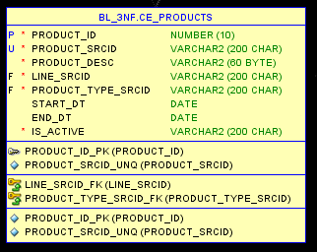
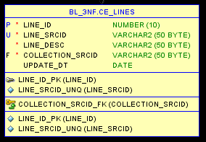
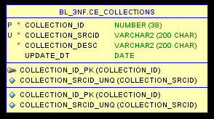

Slide 20
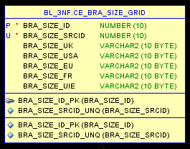
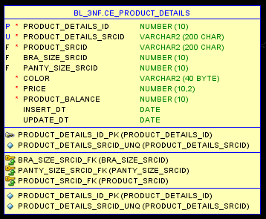
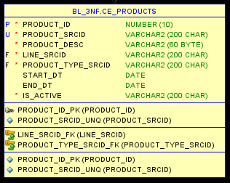
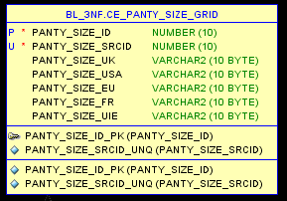

Slide 21
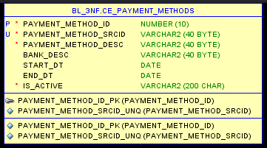
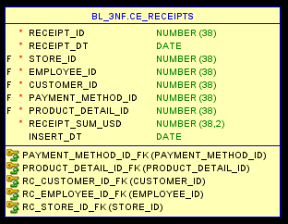
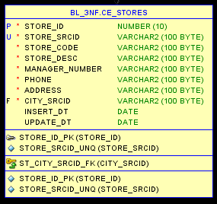

Slide 22
Load Strategy

Slide 23
LAYERS SCHEMA
SA_SRC
DIM
DIM
DIM
BL_CL_1ST
FACT
DIM
DIM
DIM
BL_3NF
BL_CL_2ND
BL_DM

Slide 24
EXTERNAL TABLES
SA_SRC
GRANTS ON READ/WRITE DIRECTORIES
ONE TO ONE
WRK TABLES
BL_CL_1ST

Slide 25
WRK TABLES
BL_CL_1ST
PACKAGES with TRUNCATE INSERT
CLEANSED
DATA
DATA
PACKAGES
CLS TABLES
BL_CL_1ST

Slide 26
CLS TABLES
BL_CL_1ST
GRANTS SELECT INSERT UPDATE
PACKAGES
PACKEGES with MERGE
ONE TO ONE
DATA
CE TABLES
BL_3NF
SEQUENCES

Slide 27
CE TABLES
BL_3NF
GRANTS SELECT
PACKAGES TRUNCATE INSERT
DATA
AGREGATED DATA
CLS TABLES
BL_CL_2ND
PACKAGES

Slide 28
CLS TABLES
BL_CL_2ND
GRANTS SELECT
INSERT UPDATE
PACKAGES
PACKAGES MERGE CURSORS
DATA
ONE TO ONE
DIM TABLES
BL_DM
SEQUENCES

Slide 29
GENERATING FACT TABLE

Slide 30
SELECT TRUNC(dbms_random.value(100000000000, 9999999999999)) AS receipt_id ,
TRUNC ( (sysdate + 4) + dbms_random.value ( 1, 1000 ) ) AS receipt_dt ,
ROUND ( dbms_random.value ( ( SELECT MIN ( store_id ) FROM bl_3nf.ce_stores),
( SELECT MAX ( store_id ) FROM bl_3nf.ce_stores) ) ) AS store_id ,
ROUND ( dbms_random.value ( ( SELECT MIN ( employee_id)
FROM bl_3nf.ce_employees
WHERE UPPER(SUBSTR(TRIM(is_active),1,4))='TRUE‘)…
============================================================================================
…( SELECT MAX ( product_details_id )
FROM bl_3nf.ce_product_details a INNER JOIN
bl_3nf.ce_products b
ON a.product_srcid = b.product_srcid
WHERE UPPER(SUBSTR(TRIM(is_active),1,4))='TRUE') ) ) AS product_detail_id,
ROUND ( dbms_random.value( 100, 99999), 2) AS receipt_sum
FROM (
SELECT *
FROM dual connect by level <1000000) );

Slide 31
THE MAIIN RULES
#1 FACT TABLE IS LOADED LAST
#2 3NF ID OF FACT TABLE ARE CHANGED WITH SURR ID OF DM-LAYER ON THE STEP OF LOADING DATA INTO FACT TABLE OF DIMENSIONAL MODEL

Slide 32
USING CURSORS

Slide 33
USAGE OF CURSORS
cls_sage_categories cls_fct_retail_sales_dd fct_retail_sales_dd
IMPLICIT CURSORS
EXPLICIT CURSORS
cls_stores_scd cls_products_scd dim_stores_scd
FORALL STATEMENT
BULK COLLECT CLAUES

Slide 34
PARTITIONING TABLES

Slide 35
DIM_CUSTOMERS_SCD
PARTITION BY RANGE (start_dt)
SUBPARTITION BY LIST (region)
DIM_EMPLOYEES_SCD
PARTITION BY LIST (position_grade)
DIM_PRODUCTS_SCD
PARTITION BY LIST (collection_name)
SUBPARTITION BY LIST (product_type)
DIM_STORES_SCD
PARTITION BY LIST (region)
FCT_RETAIL_SALES_DD
PARTITION BY RANGE (start_dt)

Slide 36
PROJECT RESULTS

Slide 37
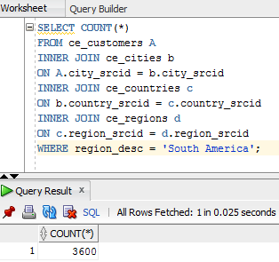
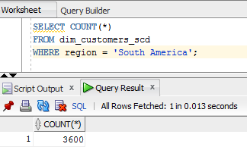
BL_3NF
BL_DM

Slide 38
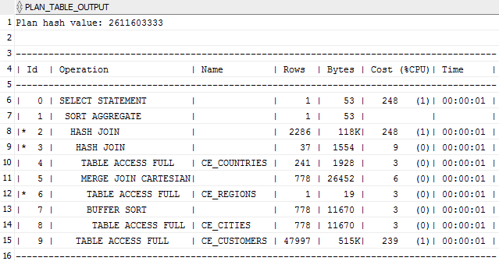
BL_3NF

Slide 39
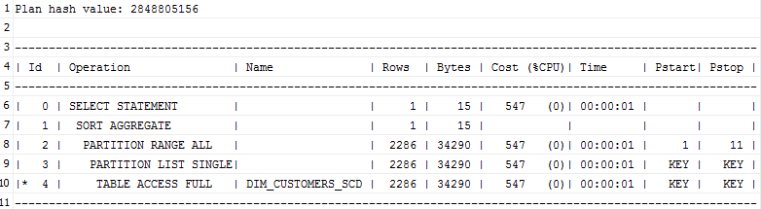
BL_DM

Slide 40
MAIN ACHIEVEMENTS
#1 all required tasks were fulfilled fully in time
#2 18 3nf-tables were created
#3 SCD1 and SCD2 types of dimensions were used
#4 cursors and partitioning were implemented
#5 two nights without sleep were realized

Slide 41
Q&A

